Slide 1
Promoting Secure Passwords
Ben Brecher

Slide 2
What is a password?
It’s a secret sequence of data
Hashed
SHA-1, SHA-256, SHA-512, etc
Seemingly random, but the same outcome each time it’s run
Same length every time. SHA-512 is 512 bits, 64 bytes, each byte is 2 HEX digits
Example: password -> B109F3BBBC244EB82441917ED06D618B9008DD09B3BEFD1B5E07394C706A8BB980B1D7785E5976EC049B46DF5F1326AF5A2EA6D103FD07C95385FFAB0CACBC86 (SHA-512)

Slide 3
How is it stolen?
Time, Patience and Computing Power
Database leaked..
it happens really often
A lot of times it is not announced as it makes the company look bad
Calculate hashes for a “guess” to see if it is right.
Methods:
Brute Force – aa, ab, ac, ad….,ba,bb,….
Dictionary Attack – Try all commonly used passwords: password, abc123, 1234
Hybrid Attack – Dictionary Attack with permutations: p4ssw0rd, p@ssword, etc

Slide 4
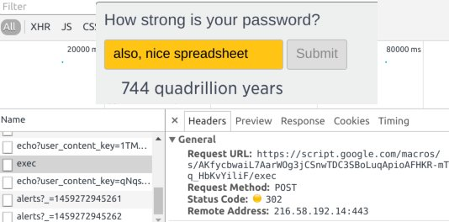
Don’t People Already Promote Strong Passwords?
No, not really.
CNBC tried…. They leaked all passwords to a Google Docs spreadsheet
https://www.extremetech.com/internet/225740-cnbc-tries-to-teach-readers-about-password-security-leaks-their-passwords

Slide 5
Don’t People Already Do This?
Do not consider dictionary and hybrid attacks
Limited Dictionary
Not very in depth
Password strength meters on registration websites are WRONG.
Short, uncomplicated passwords are labeled secure

Slide 6
My solution
I made a plugin for a website
You add the code and your own style
Can make a popup box that shows useful information
Uses wordlists from real hacking software. 306600+ Passwords
Can check for hybrid attacks
Customizagle!
This is a proof of concept!
http://passworddemo.brecher.me
Open Source under BSD-3 License: https://github.com/PasswordSecurity/Demo

